Slide 1
Vehicle Identification and Counting through Traffic Cams
Tim Herrmann and Mikhail Todes
March 7th, 2016

Slide 2
Sequential Imaging
Consecutive frame subtraction:
Capture a frame
Capture a second frame
OpenCV function cv::absdif(Mat Frame1, Mat Frame2, Mat Difference);

Slide 3
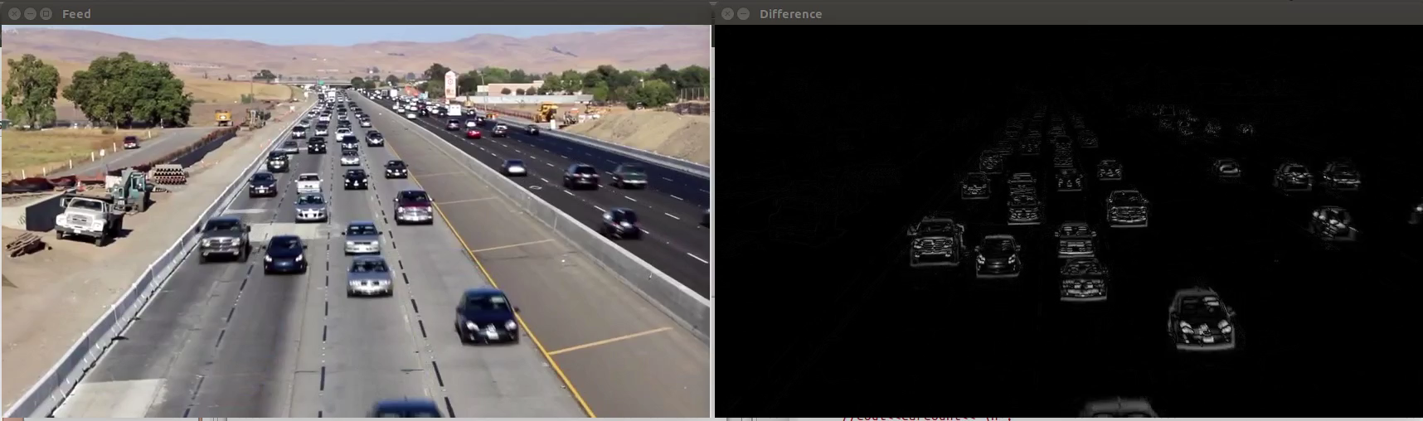
Sequential Imaging

Slide 4
Sequential Imaging
Thresholding:
GaussianBlur to smooth before the absdiff
OpenCV function threshold(InputArray src, OutputArray dst, double thresh, double maxval, int type)
threshold(diff, thresh, 50, 255, THRESH_BINARY);

Slide 5
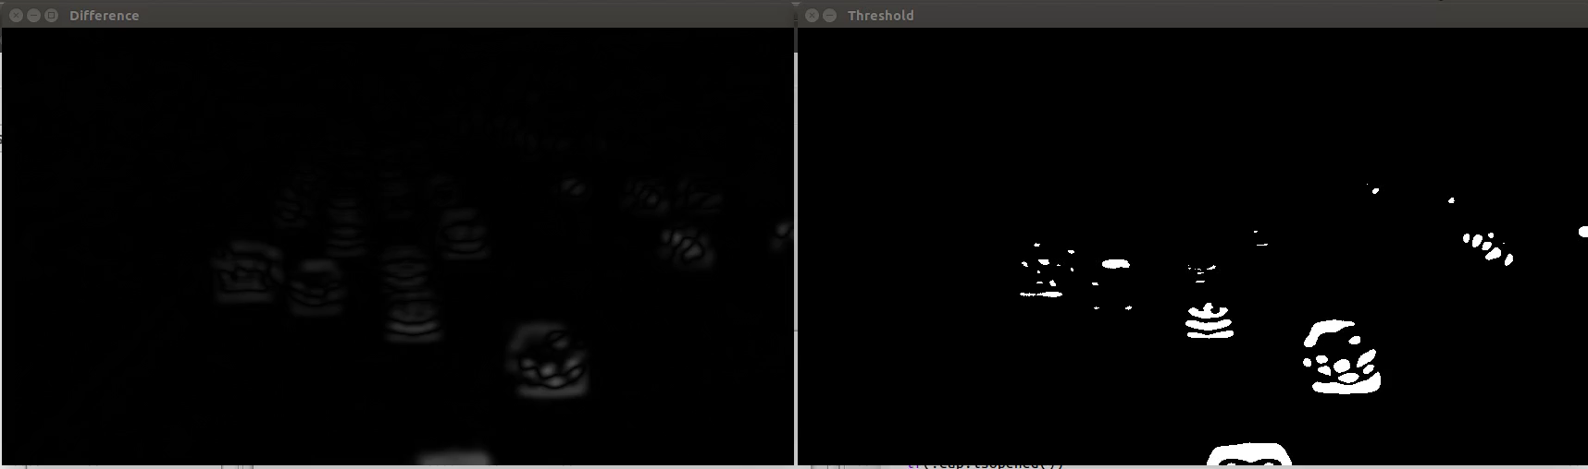
Sequential Imaging

Slide 6
Sequential Imaging
Morphological Operations:
Could Decrease the threshold minimum
Better to Erode and Dilate

Slide 7
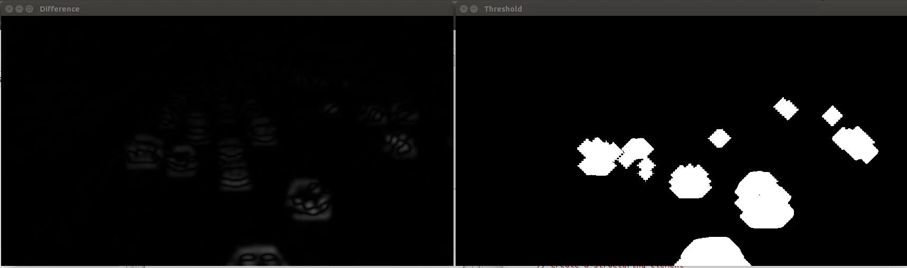
Sequential Imaging

Slide 8
Sequential Imaging
Tracking:
OpenCv findContours
Check if contours is empty
If not, loop through them all
Record the x and y center position
Draw a bounding rectangle

Slide 9
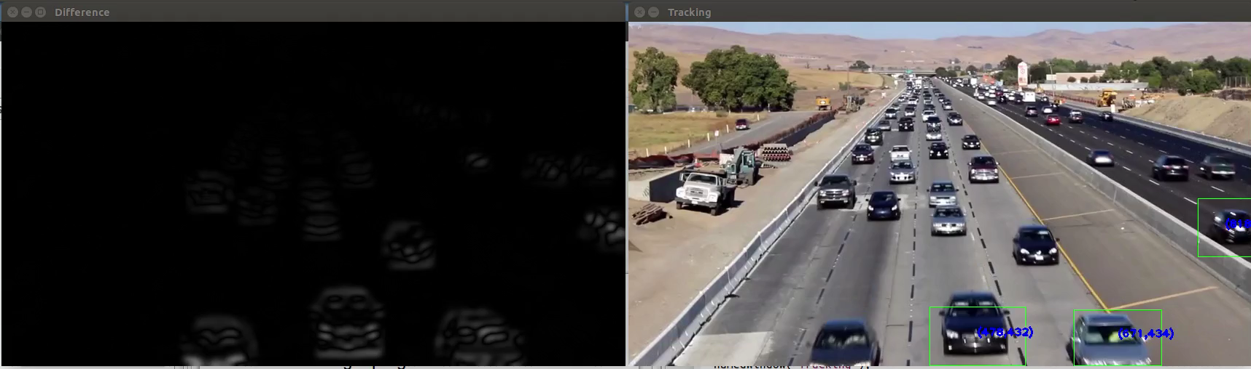
Sequential Imaging

Slide 10
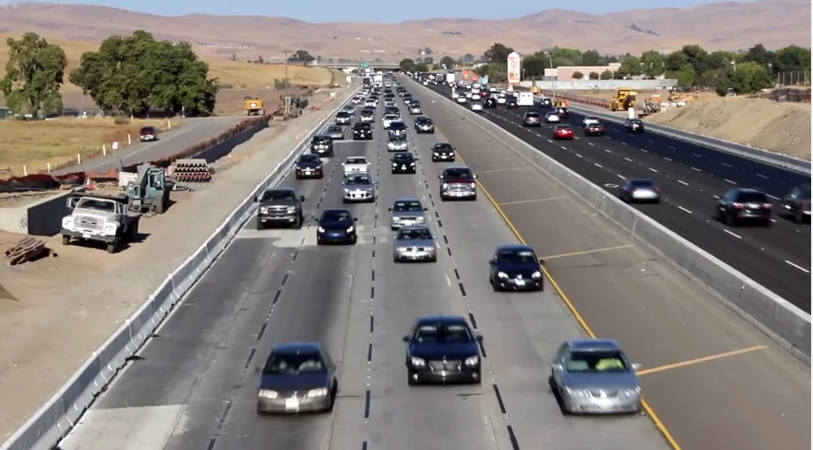
Background Subtraction
Separate the moving dynamic object from static background
Easy to do if you have a clean image of only the background.
OpenCv – cv2.BackgroundSubtractorMOG()
P. KaewTraKulPong and R. Bowden in 2001
Can specify number of frames to include in history, and background ratio
Mixes multiple Gaussian filters
Calculates a probability that each pixel is part of the background
The longer a pixel is static, the higher it’s probability
Any pixel more than 2.5 standard deviations from any of the filters is marked as foreground
Video curtesy of https://www.youtube.com/watch?v=SRPW14WcLFs

Slide 11
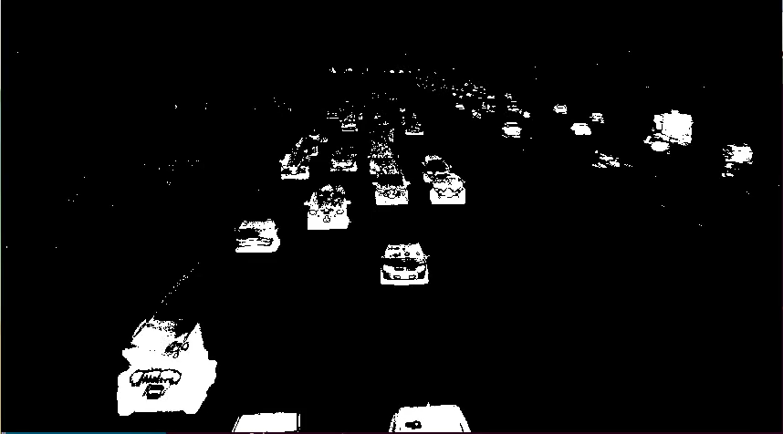
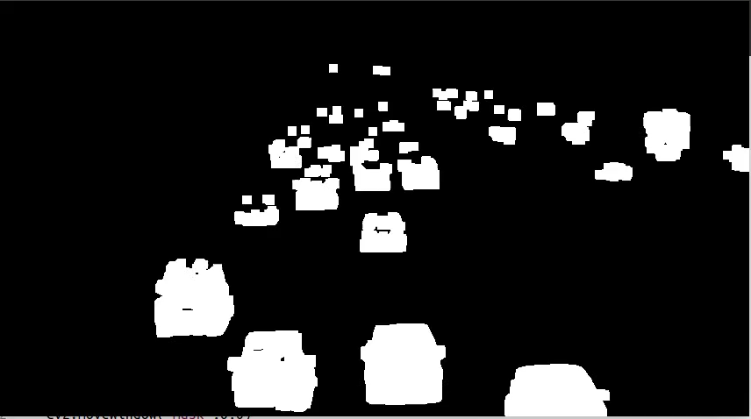
Background Subtraction

Slide 12
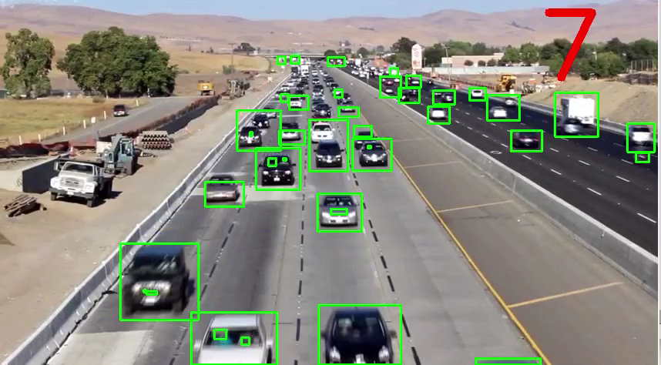
Background Subtraction
Contours and bounding rectangles to identify each object
Problems:
Difficult to detect at distance
Erosion/Dilation not always perfect
Small regions can be “jumpy”
Solution:
Only attempt to detect vehicles at the bottom of the image where resolution is much better
Set a minimum rectangle size

Slide 13
Background Subtraction
How do we count?
Difficult to consistently track unique rectangles from frame to frame
Solution:
Track contours entering and leaving a band
Calculate vertical position of each contour centroid.
For any centroid inside the band, sum up the pixel distance to the end of the band
The sum will slowly decrease until a new contour enters the region, when it will jump by ~50 for each vehicle entering
50
y
0

Slide 14
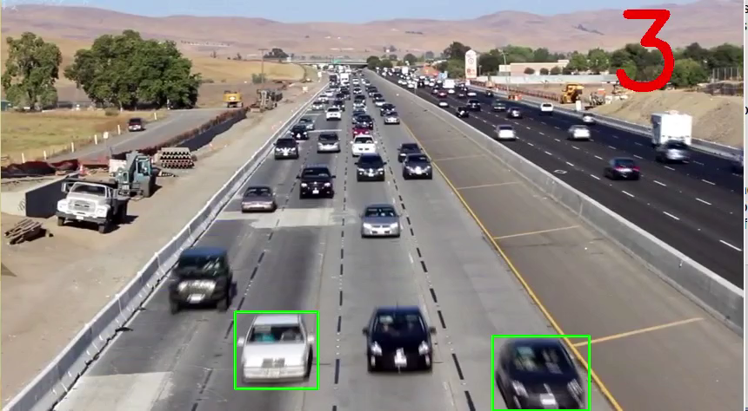
Final Result
First 150 frames are cut out to allow the background model to generate

